Slide 1
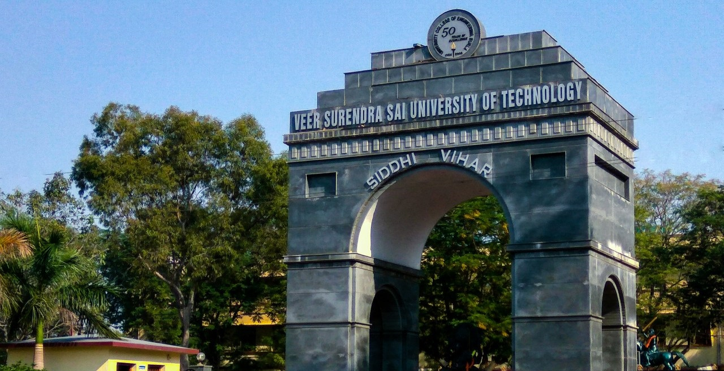



SAMAVESH 2k18
Annual Techno-Management Fest
Todays Fiction is Tomorrows Creation
VSSUT BURLA
2017-18

Slide 2
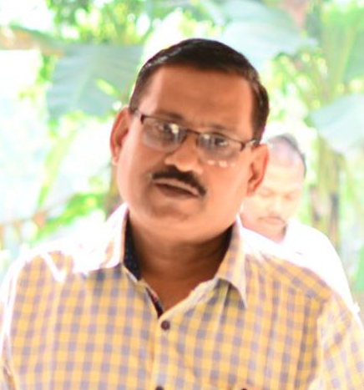
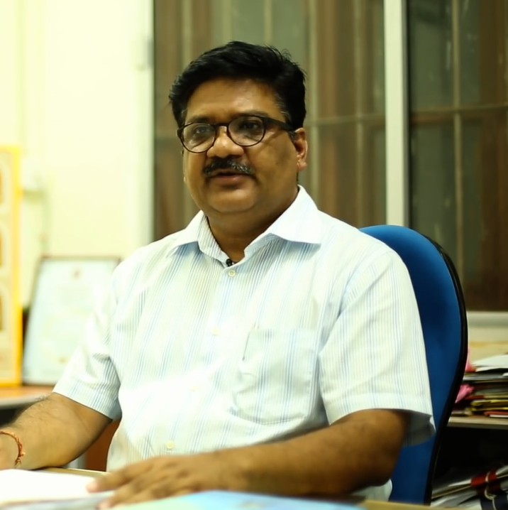
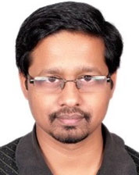
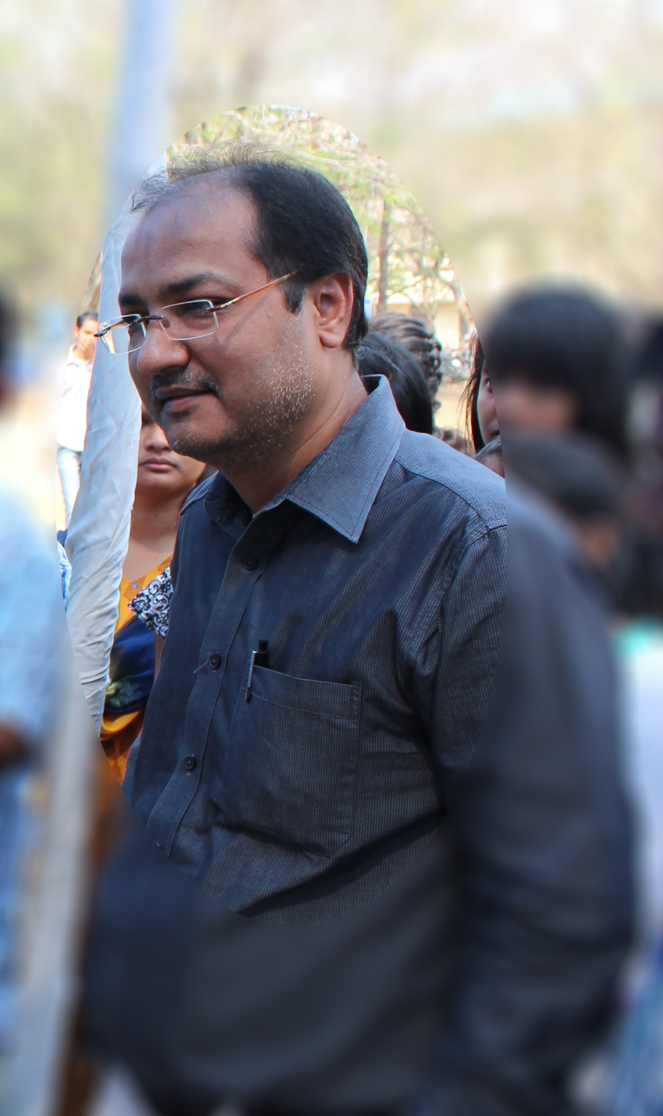
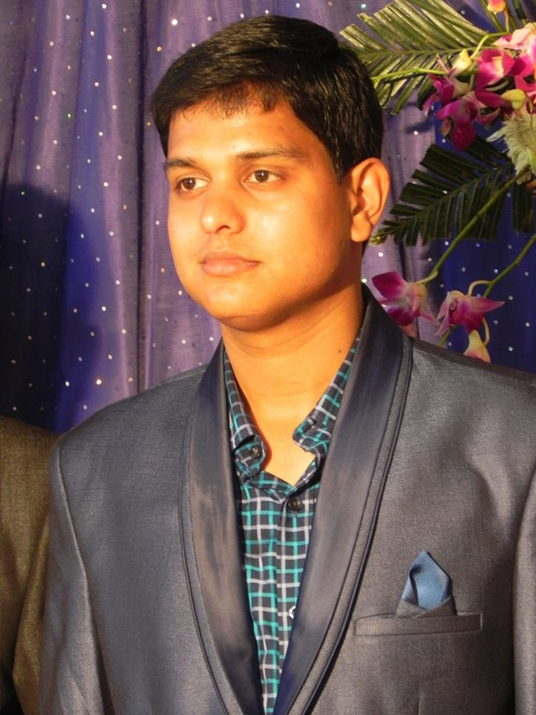
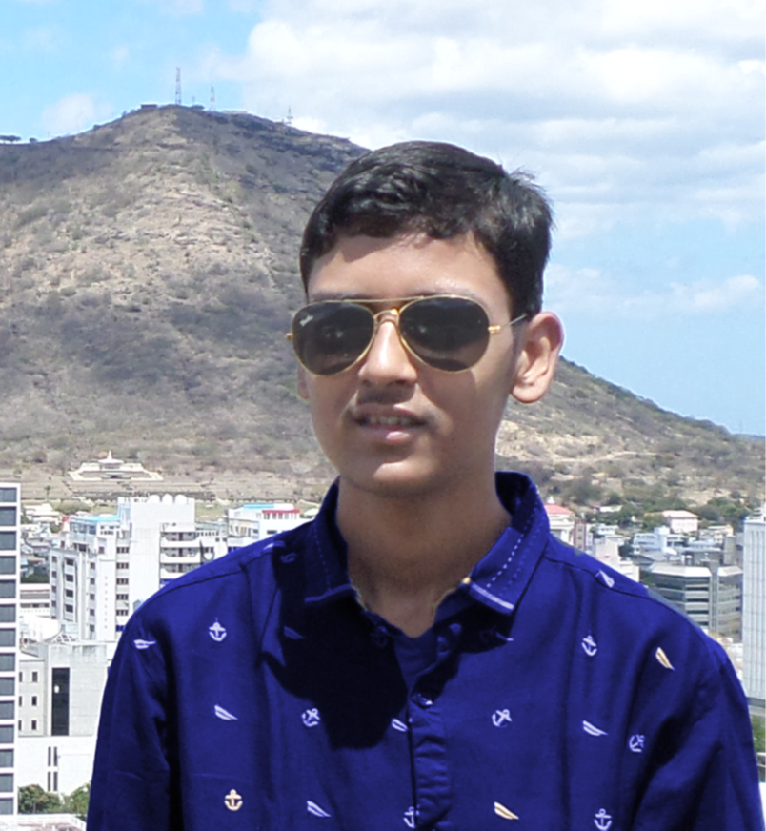
ORGANISATION
Prof. Bibhuti Bhusan Pati
Hon’ble Vice Chancellor
VSSUT, BURLA
Prof. Debadutta Mishra
Dean, Students' Welfare
HOD Production Engineering
Dr. Gyan Ranjan Biswal
Vice President, Technical Society
Associate Professor, Electrical Engineering
Mr. Sanjaya Kumar Panda
Faculty Advisor, Samavesh
Assistant Professor, Information Technology
Mr. Apurwa Masook
Co-ordinator, Samavesh
Pre-Final year, Civil Engineering

Slide 3

ABOUT US
Samavesh or the Devanagari meaning of “Confluence of ignited minds” is the Annual Techno-Management fest of Veer Surendra Sai University of Technology, Burla. Ever since its inception Samavesh has lived upto its name of being the largest technical gathering in the state. Samavesh witnesses huge gathering of technocrats, business moguls, industry experts, scientist and students who expressed keen interest in technology.
Science Fiction or popularly known as “Sci-Fi” is the central theme of this year’s fest which is testimony to the fact that what may be ignored as a fiction may be tomorrow’s biggest creation. To replicate its wonder is the very thought of this year’s fest and would prove exhilarating yet challenging for our next generation.

Slide 4
MEGA EVENTS
National Tech Expo
To bring the Technological Advancements made by the Youth across the country to limelight.
National Hack-a-thon
A popular design sprint-like event in which makers and innovators collaborate intensively on projects.
Internship Fair
To bridge the gap between the talented pool of students and companies through an Internship Fair which will be a perfect platform to meet potential employers, create networks and gain challenging opportunities to work and learn.
Business Conclave & Entrepreneurial summit
A platform for student enthusiasts to connect to Visionaries and share thoughts and experiences. Experts from Industry and Academia address important concerns, and galvanise their efforts towards forging successful and mutually beneficial partnerships.
Workshops
Exposure to Latest Technological Advancements through Workshops for Skill Development.

Slide 5
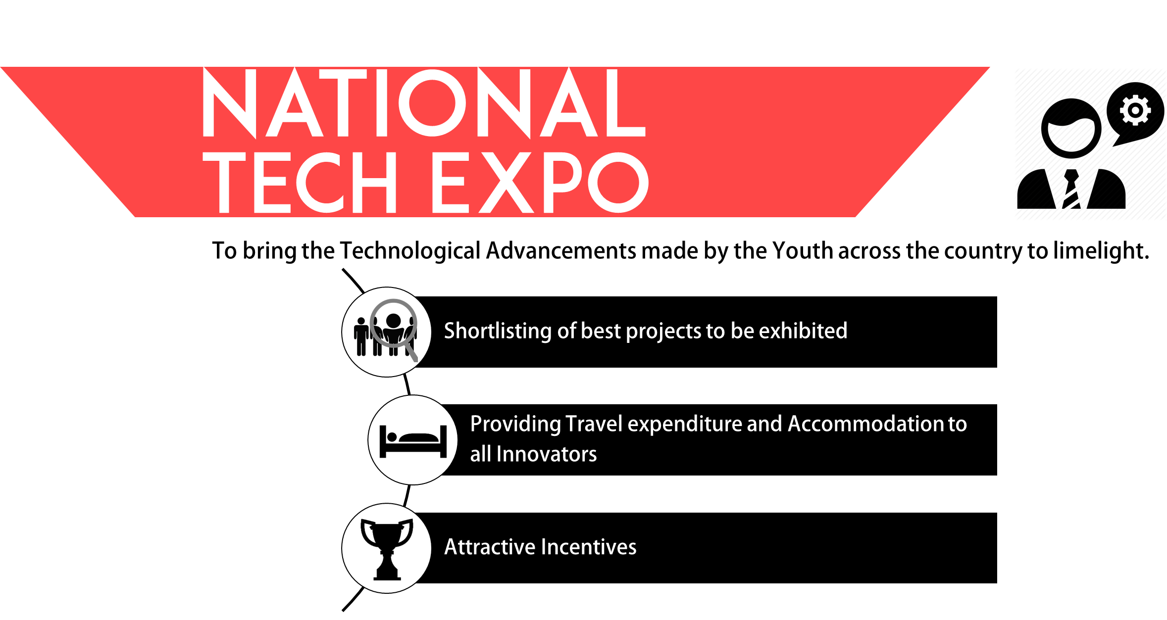

Slide 6
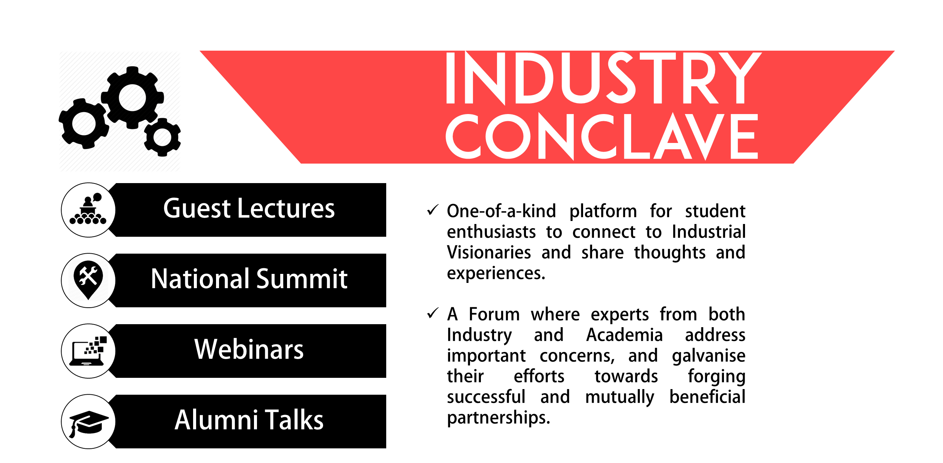

Slide 7
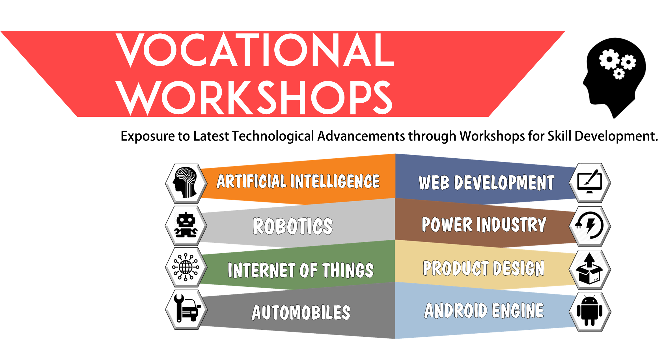

Slide 8
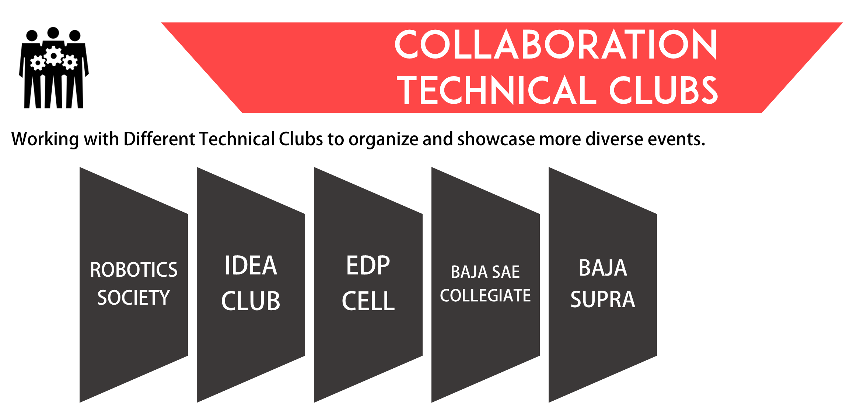

Slide 9








Help others Achieve their
Dreams and you will Achieve yours
LES BROWN

